Slide 1
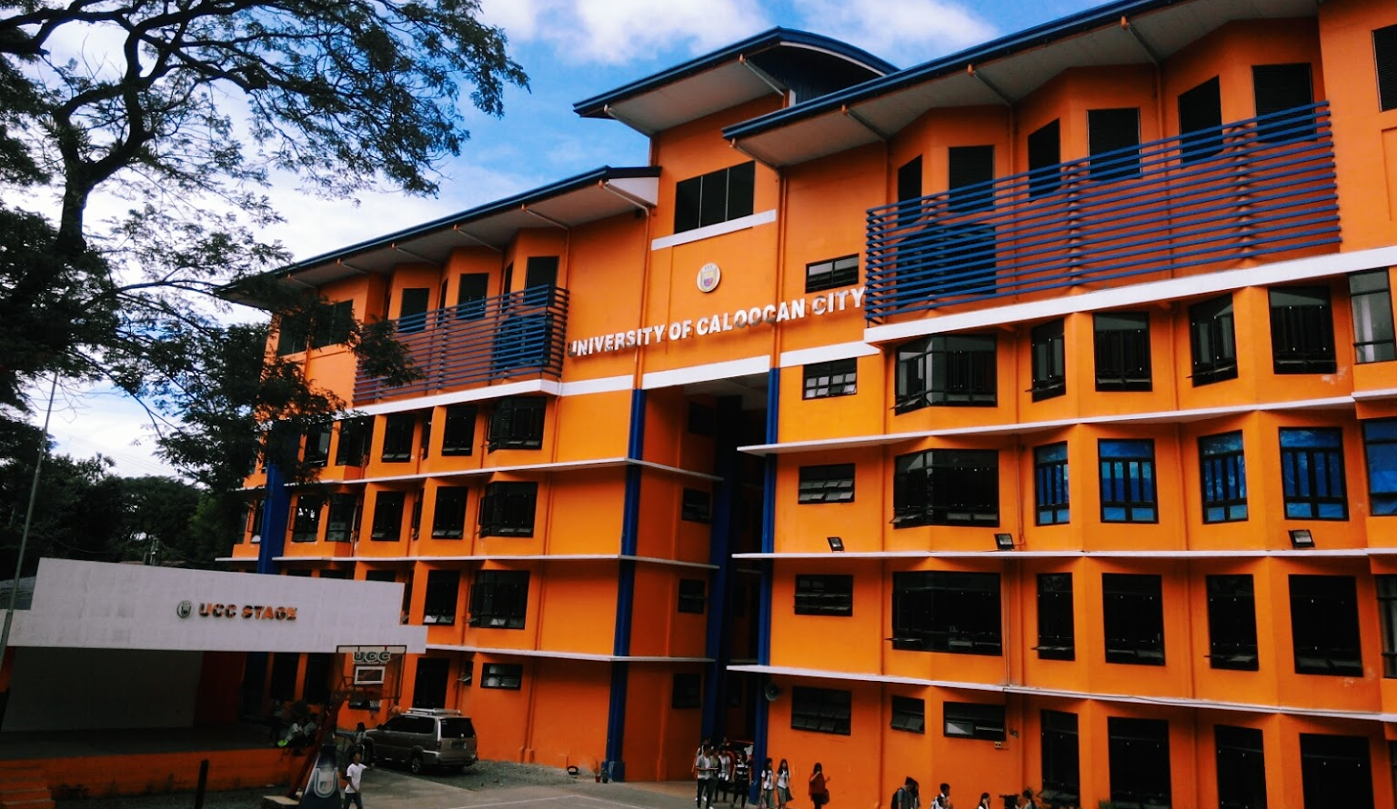
ALUMNI MANAGEMENT SYSTEM
PROJECT PROPOSAL
Notes:
Introduction of Members

Slide 2
Connect
Notes:
Discuss this / In relation to Alumnus and University

Slide 3


There is no existing Alumni Management System
PROBLEM STATEMENTS
The only communication of the alumnus to the school are through Facebook and messenger
Transactions that was made by an alumnus was only at paper and no record on cloud

Slide 4



Cons of the FB Group
Reliability
Security
Unorganized
1
2
3
Notes:
Relibility – Facebook group can be loss
Security – Dummy account can join
Unorganized – Facebook group is general purpose, not tailored to Alumni

Slide 5

Notes:
Introduce - Title

Slide 6
CSConnect
A Software Solution
Notes:
Name subject to change
Discuss General Objectives

Slide 7
SPECIFIC OBJECTIVES
To Improved Communication
To Provide Better Credibility
To Provide Secured and Reliable Platform
Email Communication
Store and Maintain Database
Required Verification
Event and Social Media Updates
Job Posts
Group Discussions
Store their Academic Profiles
Companies they're associated with
Position they hold

Slide 8







SYSTEM FEATURES
Event Management
Jobs Board
Discussion/Forums
1
2
3
Member Accounts
Chat Support
Requesting for Items such as ID and T-Shirts
4
5
6

Slide 9
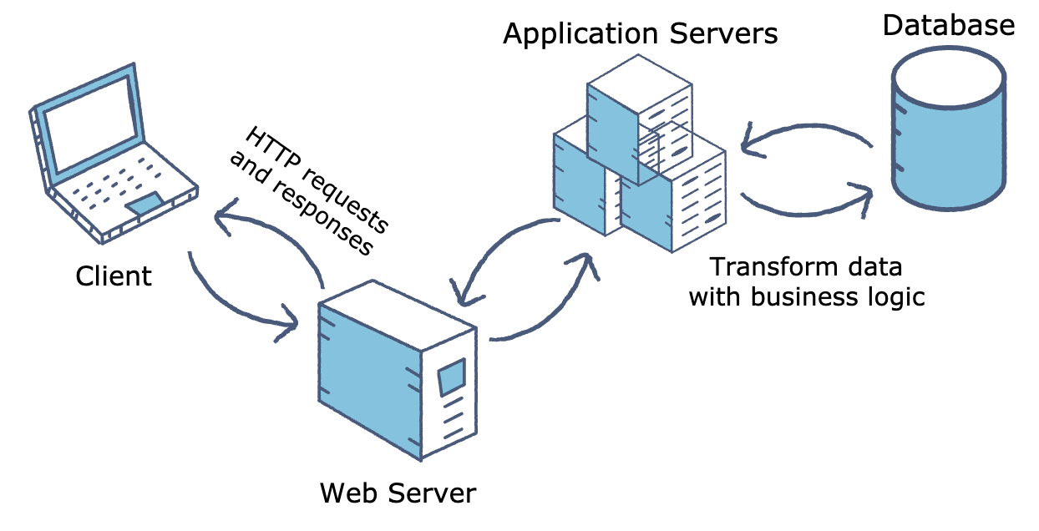
Deployment

Slide 10
BUDGETARY RISKS
Yearly Payment for:
- Domain Name
- Web Hosting

Slide 11
Warranty and Maintenance
One (1) year of warranty
Identified functions will be maintained.

Slide 12
Training and Support
15 hours personal training for Admin users.
Online documentation.
Chat Support from developers.

Slide 13




THANK YOU
Special thanks to Fabrikam inc. For this awesome template
Lenard Mangay-ayam
(CSConnect Leader)
(+63) 948 537 9875
lenard.mangay-ayam@gmail.com

